Slide 1
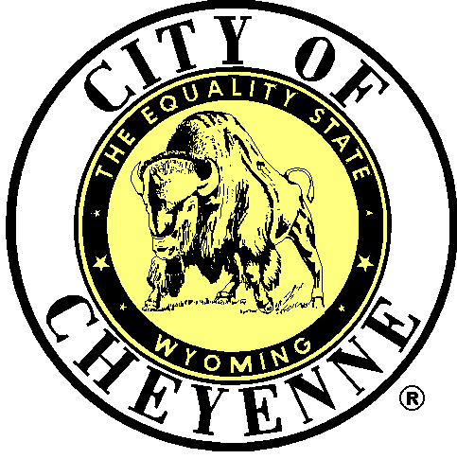
1% OPTIONAL SALES TAX and constitutional amendment A general election NOvember 8, 2022

Slide 2
OVERVIEW
Information & History
Past Sales Tax Use
2023-2026 Distribution
2023-2026 Projected Sales Tax Use
Constitutional Amendment A

Slide 3
INFORMATION & HISTORY
Tax Authorized by State Statute
  Title 39, Chapter 15, Article 2
Voter Approval Required
First Adopted by Voters in 1977
  Not a New Tax
  Renewed Every Election Since 1977
Distribution Based on Population
May be Used as General Revenue
City Specifies How Funding is Used
  City Ordinance Chapter 3 Para 3.08.010
  Resolution No. 6248 dated June 27, 2022

Slide 4
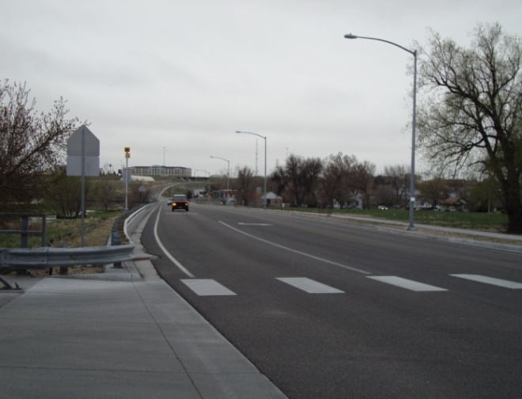
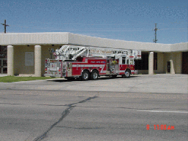
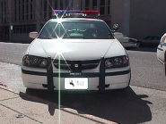
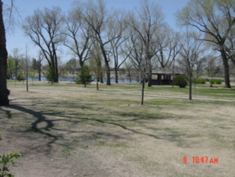
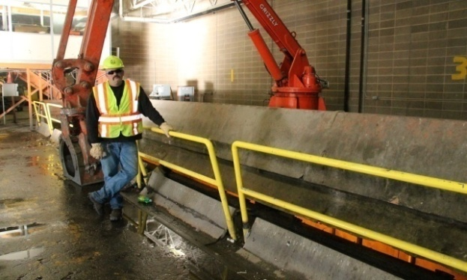
PAST SALES TAX USE
80% Designated to Streets
  Multiply Use with Grant Match
Remaining 20%
  Fire
  Police
  Community Rec & Events
  Capital Equipment
  City/County Health
  Animal Control
  Airport Property Leases
  Human Services
  Economic Development

Slide 5
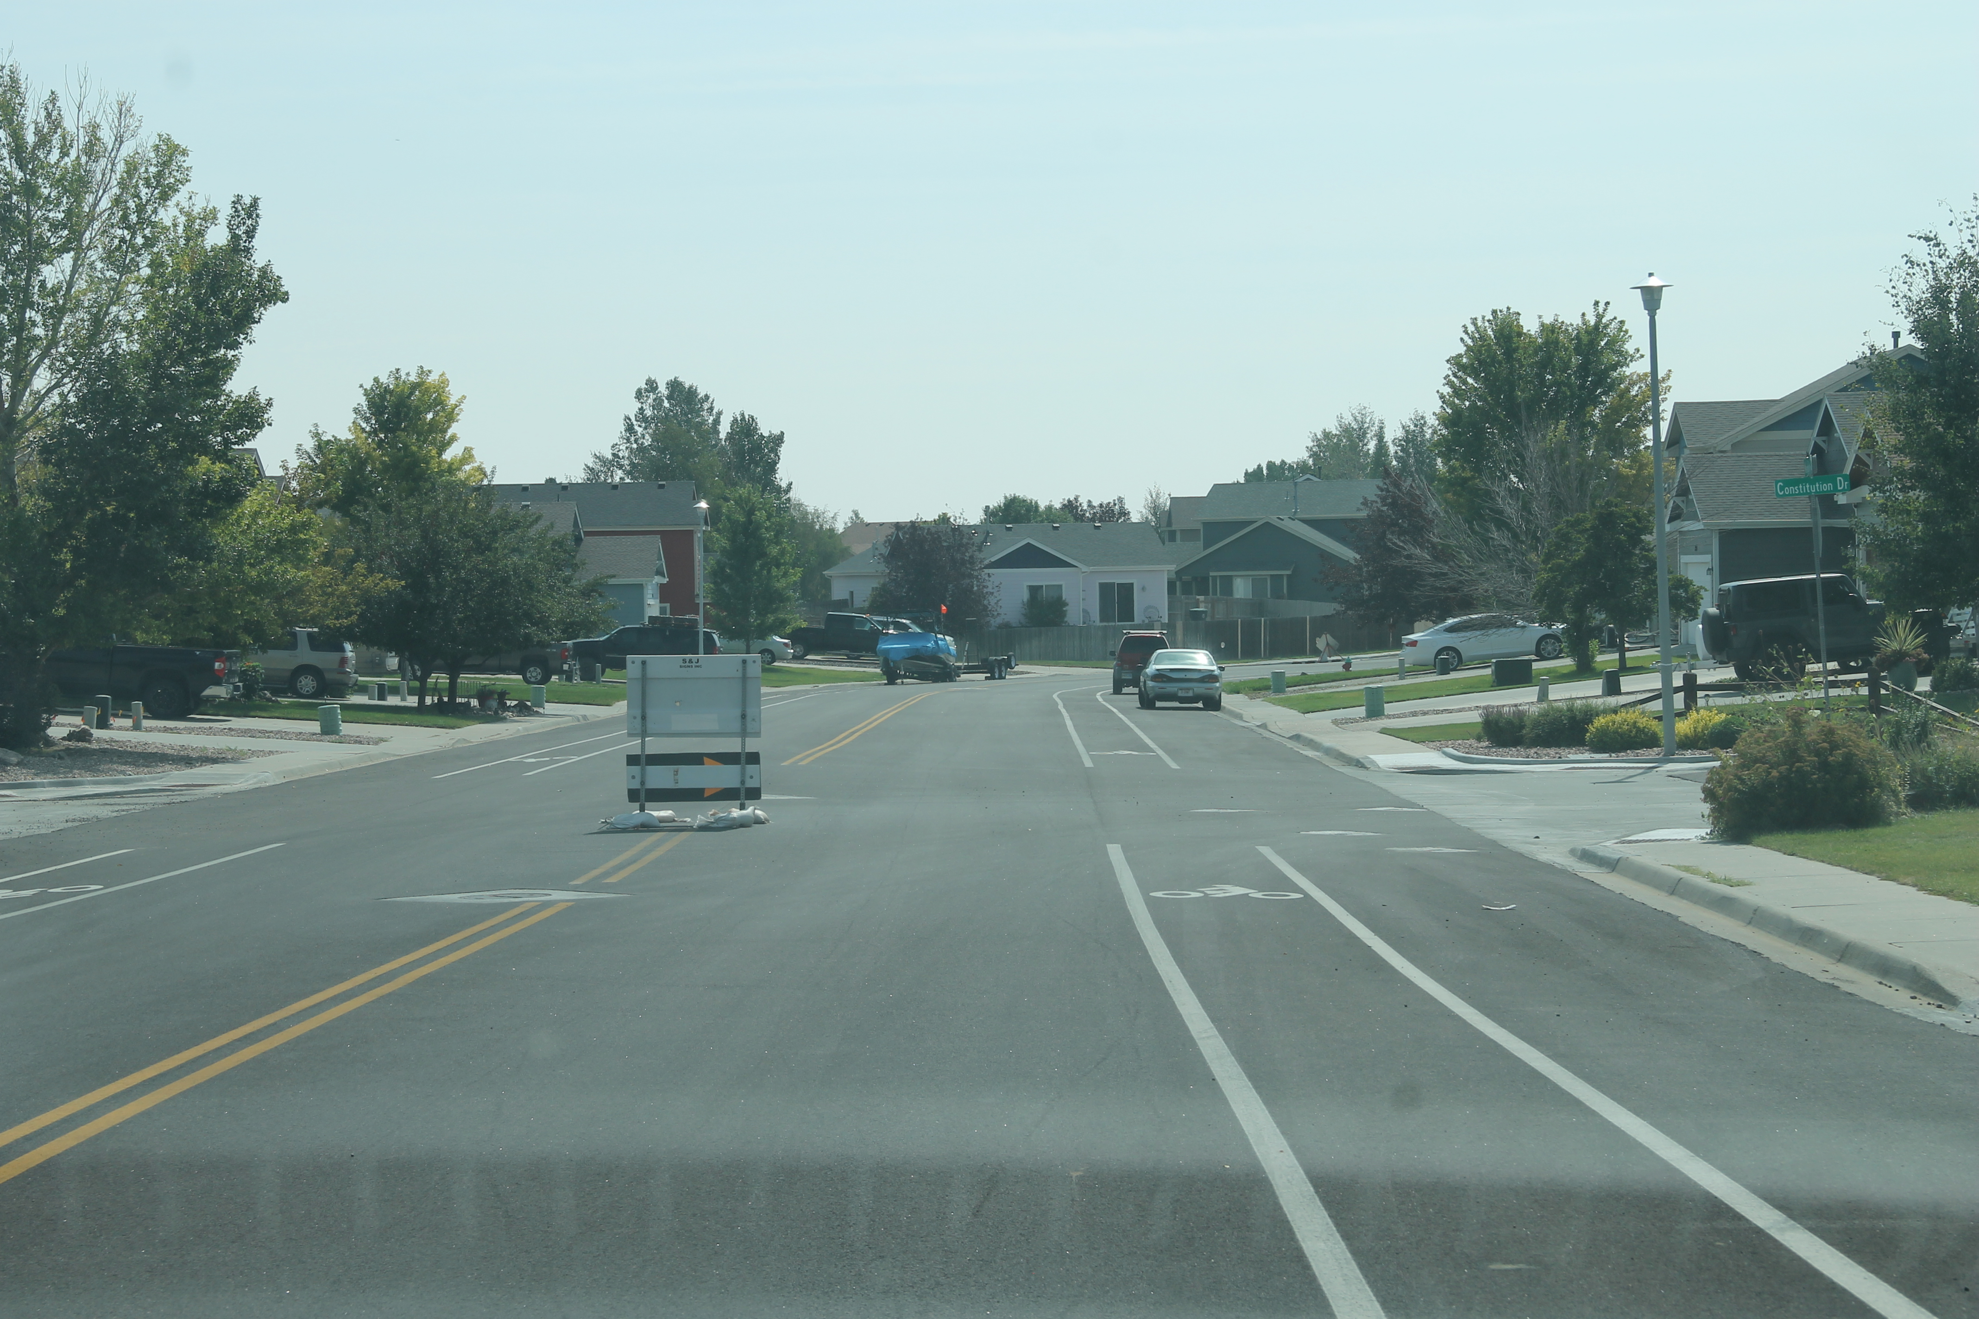
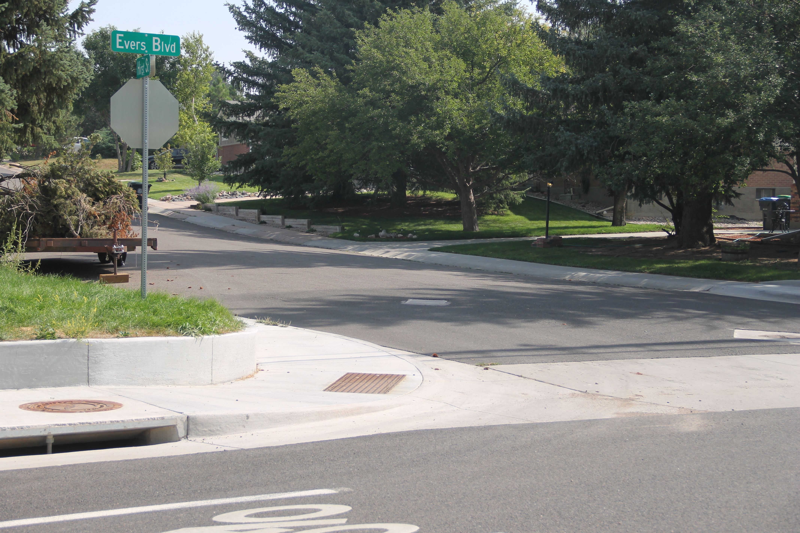
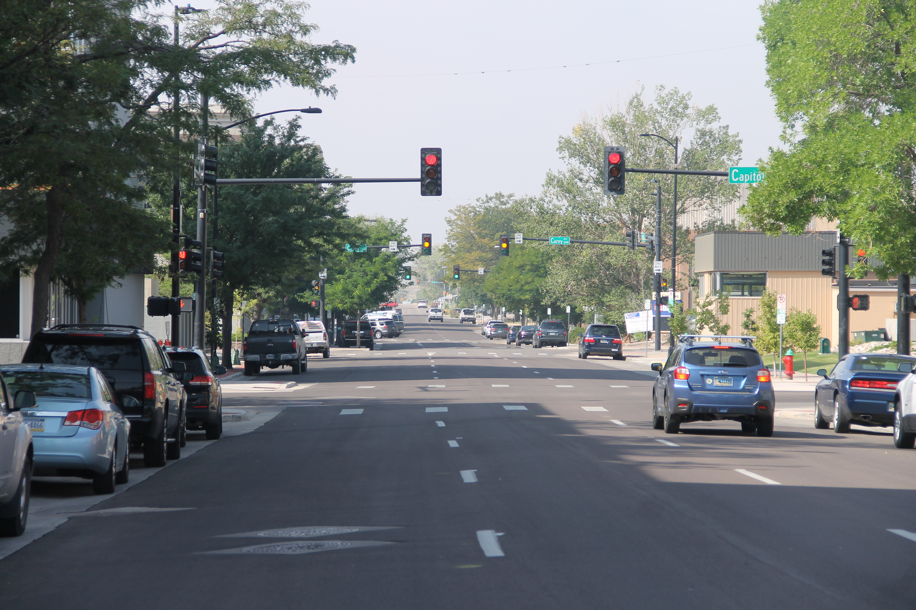
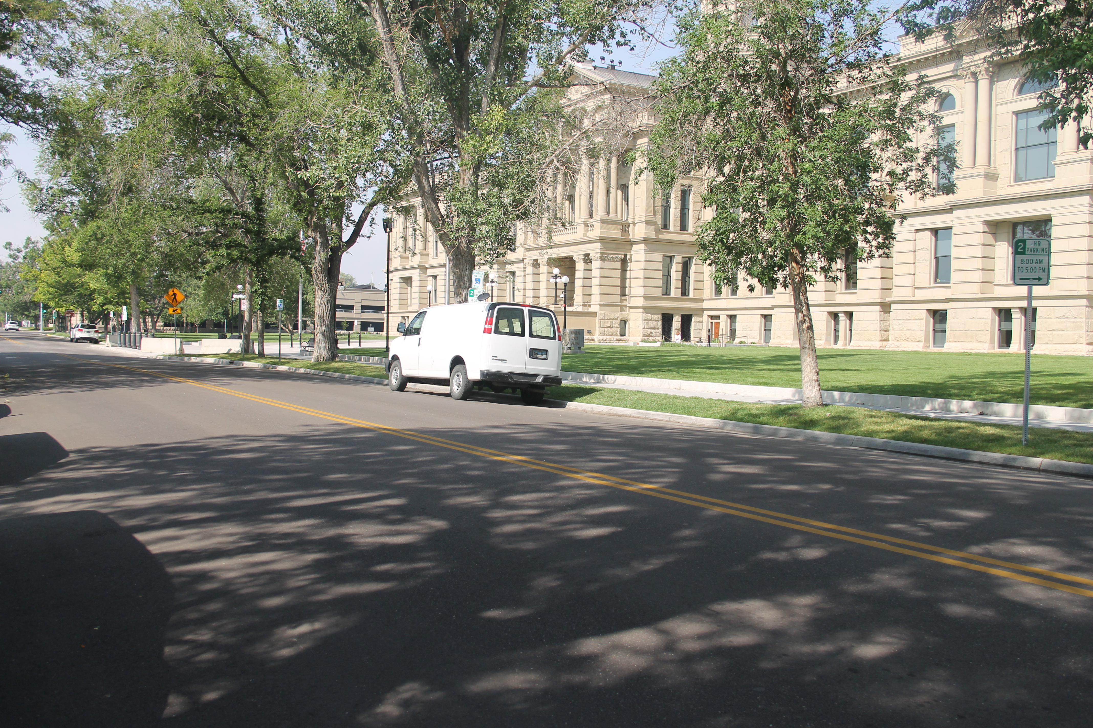
Completed Street Projects
20th Street
Evers Boulevard
Meadow Drive/12th Street
24th Street
26th Street Storm Sewer

Slide 6
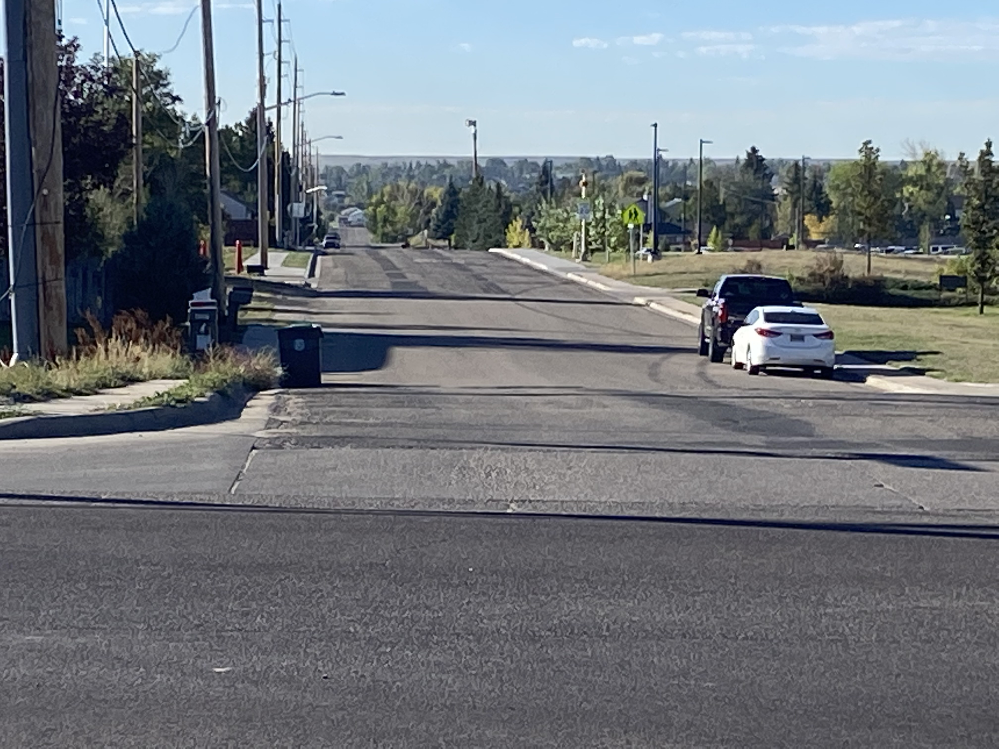
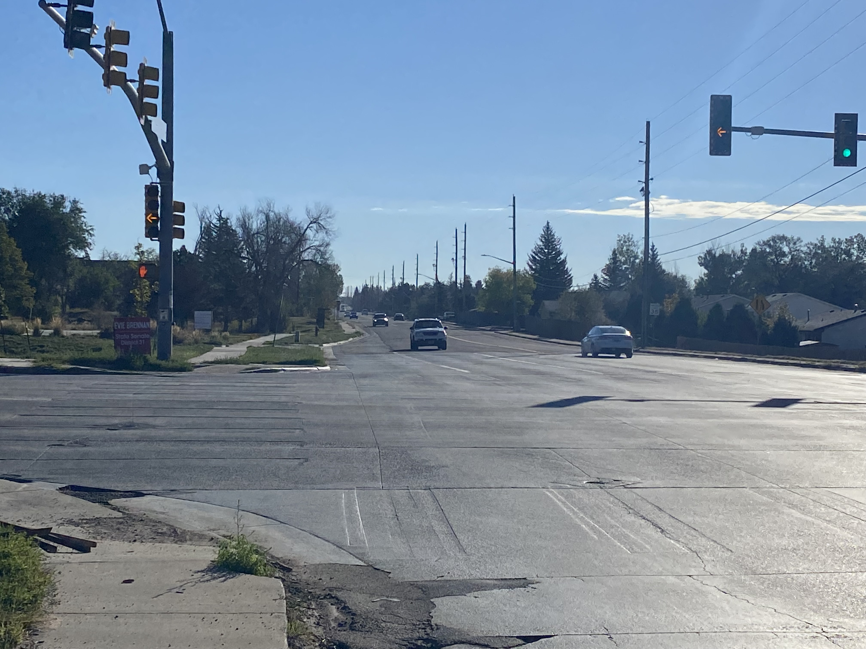
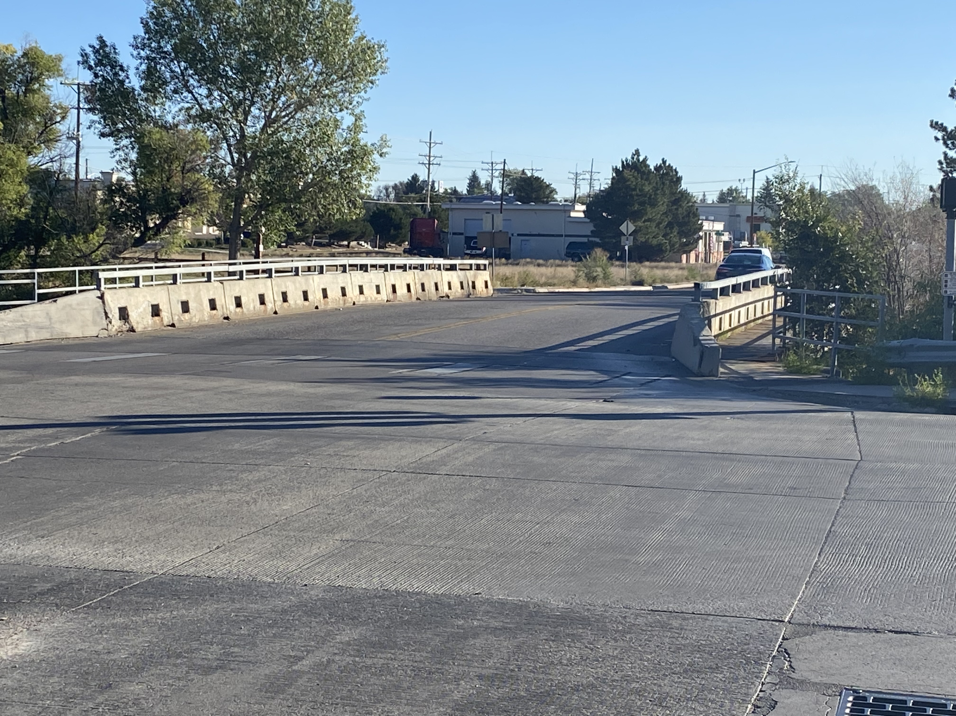
Upcoming Street Projects
  5th and Deming Bridge Replacement
  Dell Range Reconstruction/Widening
  Van Buren Storm Sewer Interceptor
  Maintenance Projects

Slide 7
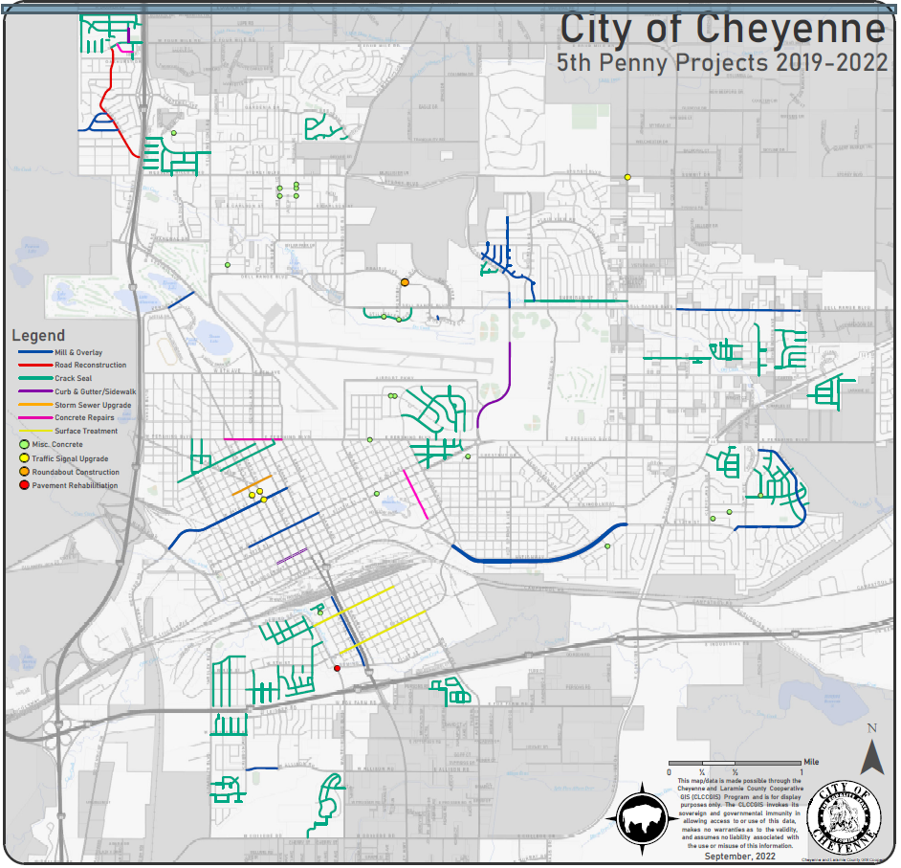

Slide 8
DISTRIBUTION
  Estimated Total County Collection 2023-2026
    $78,000,000
  Distribution Based on Population
    City of Cheyenne = 64.9079% = $50,628,162
    County = 33.3388% = $26,004,264
    Pine Bluffs = 1.2288% = $958,464
    Burns = .3276% = $255,528
    Albin = .1970% = $153,660
    Note: Estimated Distribution based on 2020 Census.

Slide 9
2023-2026 City Estimate $50,000,000
  Collected Over 4 Years ($12,500,000 yr)
    80% to Streets & Roads
    20% to Fire, Police and Other Agencies
  100% of Overage Designated
    80% Overage Designated to Streets & Roads
    10% Overage Designated for City Operations and Maintenance Projects
    10% Overage Designated to Fire, Police, Community Recreation & Events, Capital Equipment, City/County Health, Animal Control and Human Services
      Airport Board & Joint Powers Economic Development Board Do Not Receive Overage Funds

Slide 10
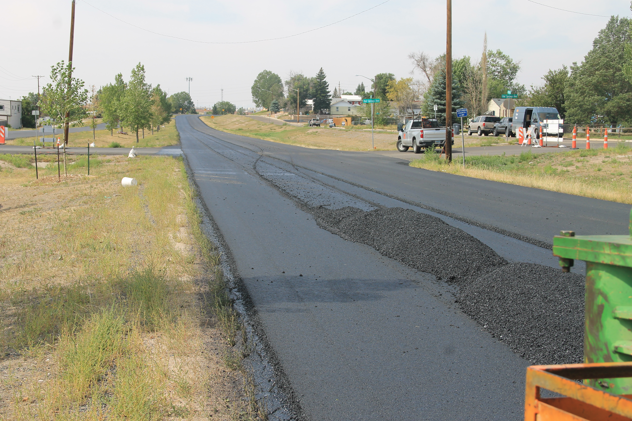
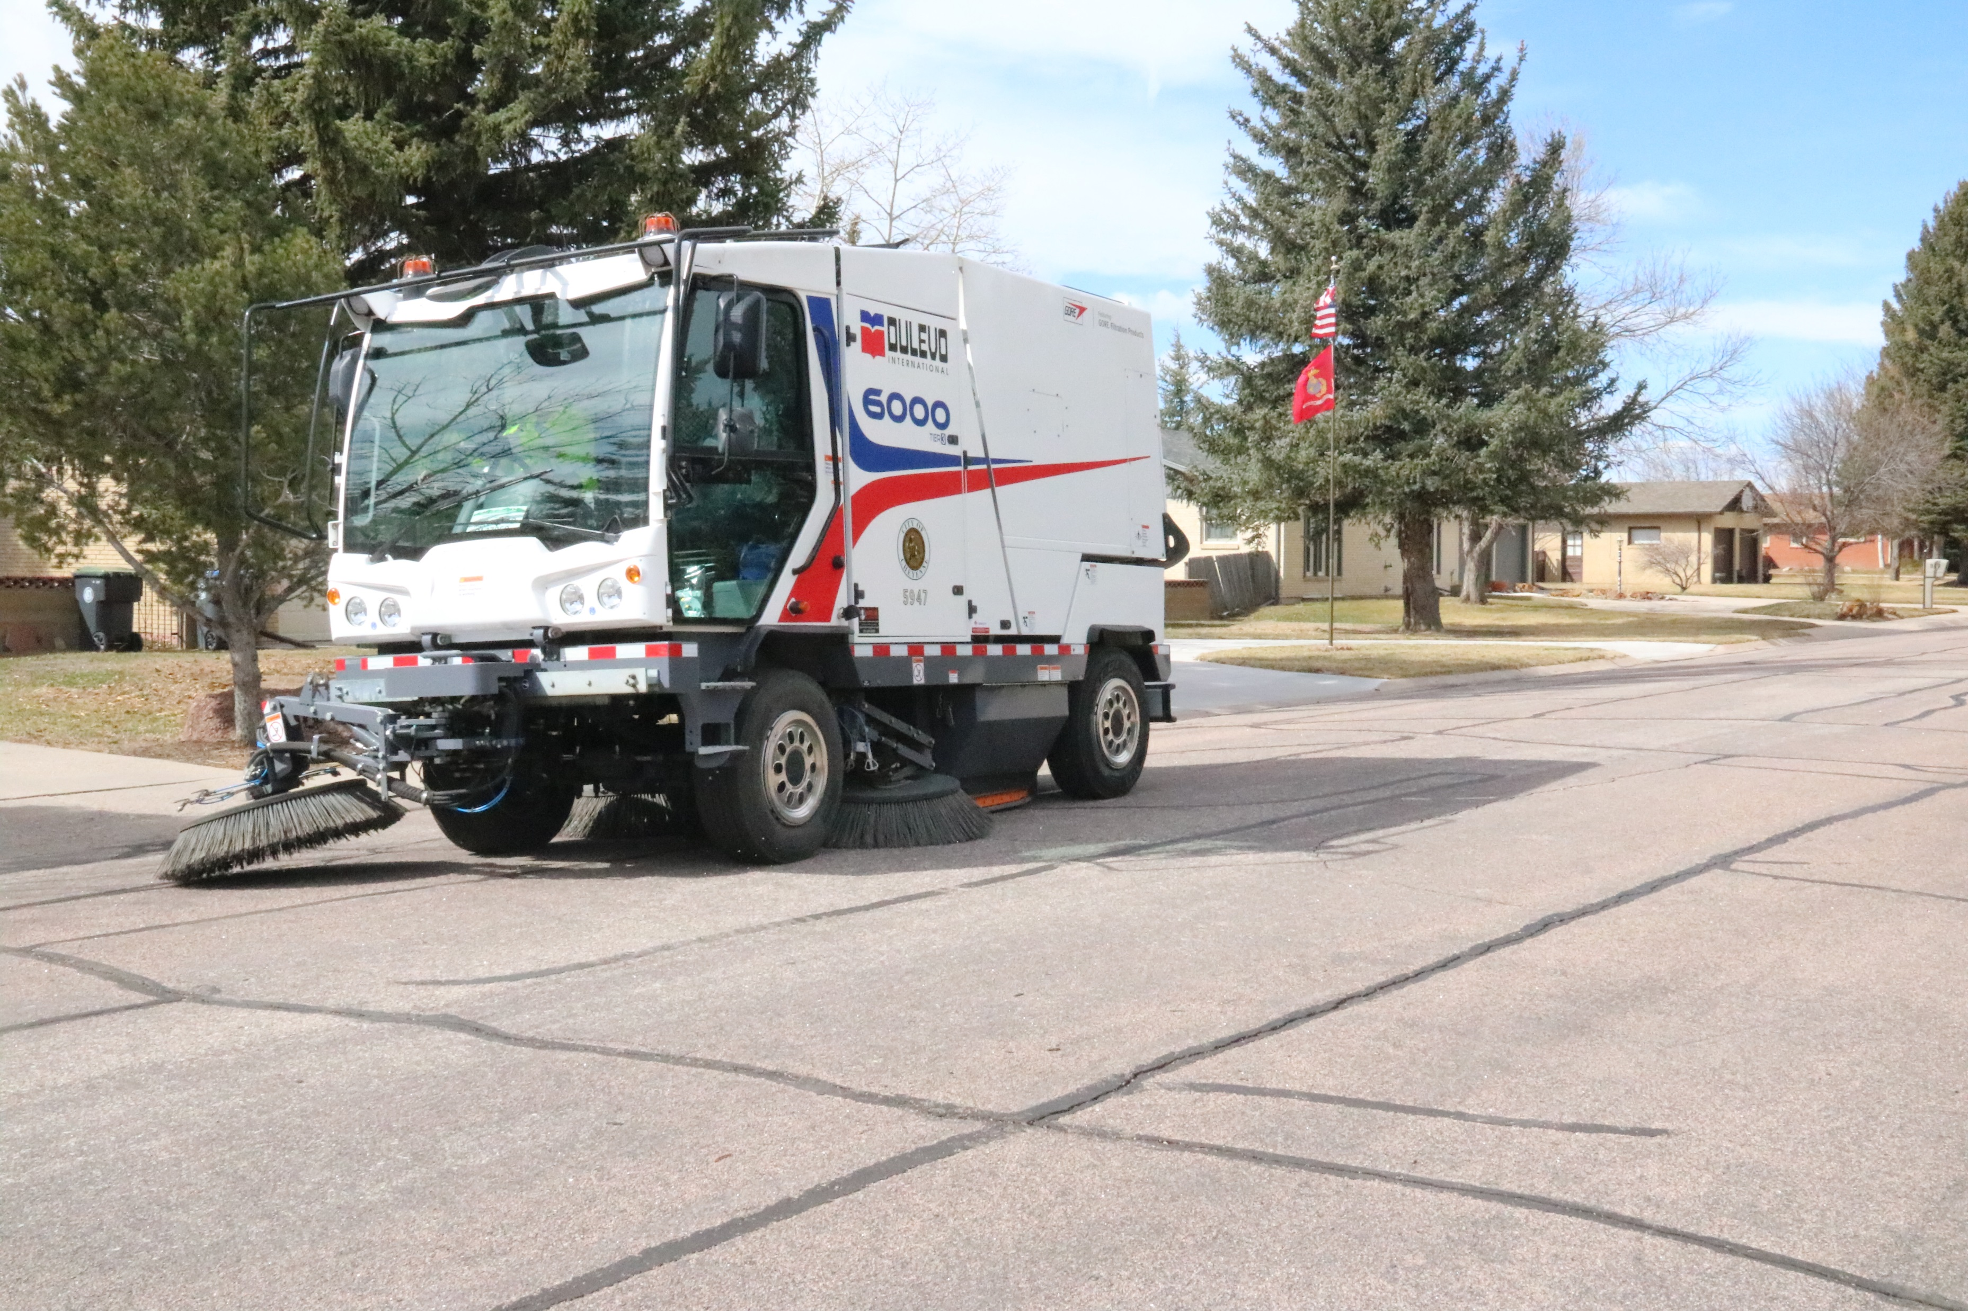
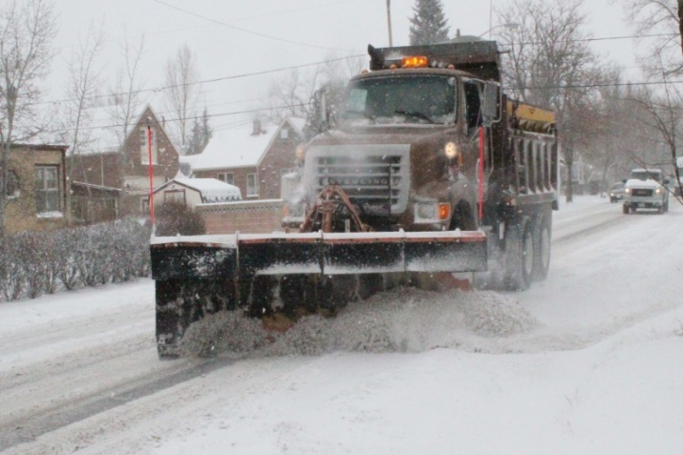
Street Related Work 80%
  City Street and Road Maintenance
    $25,000,000 ($6,250,000 yr)
    Street Maintenance, Sweeping, Asphalt & Ice Melt Products, Equipment Replacement, Snow & Ice Control, Dust Control
    Grind & Overlay
    Slurry Seal, Chip Seal & Crack Seal
    Concrete Street & Intersection Repair, ADA Ramps

Slide 11
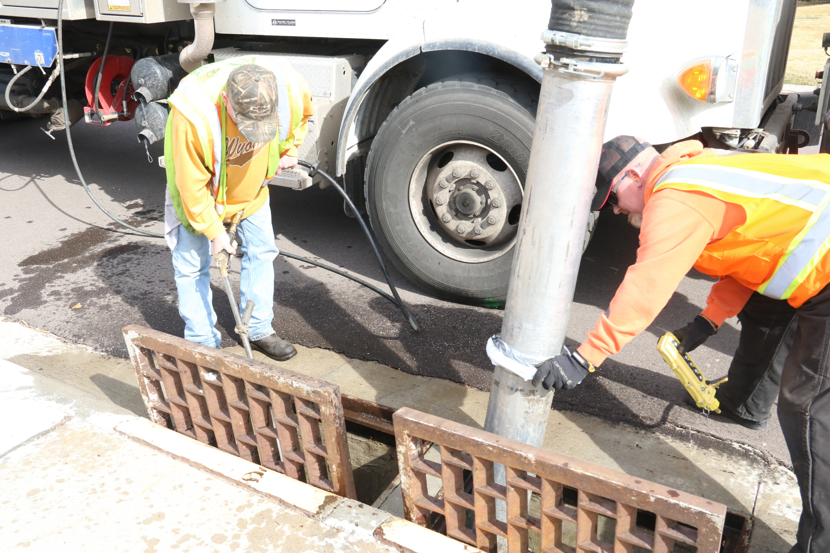
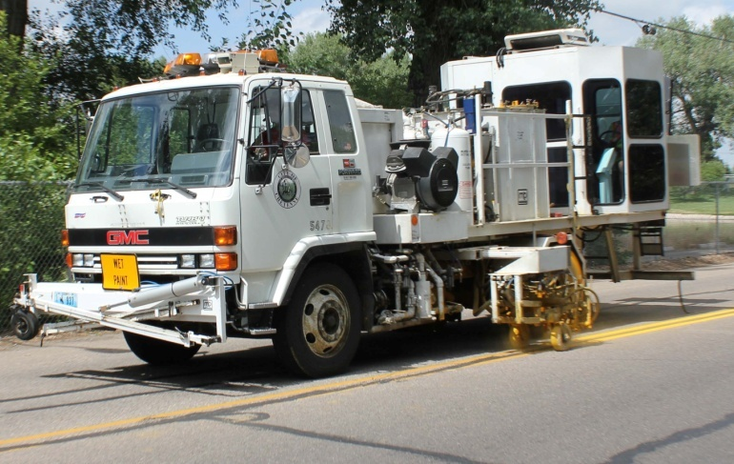
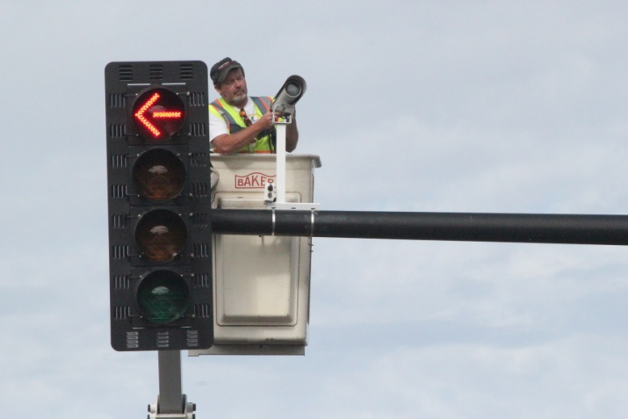
Street Related Work
  Traffic Safety Improvements $3,000,000 ($750,000 yr)
    Traffic Signals, School and Pedestrian Signals, Traffic Signs, Traffic Paint and Equipment
  Drainage Maintenance $4,000,000 ($1,000,000 yr)
    Maintenance & Repair of Storm Sewers, Inlets, Culverts, Drainage Channels and Detention Ponds
    Address Water Quality in Creek

Slide 12
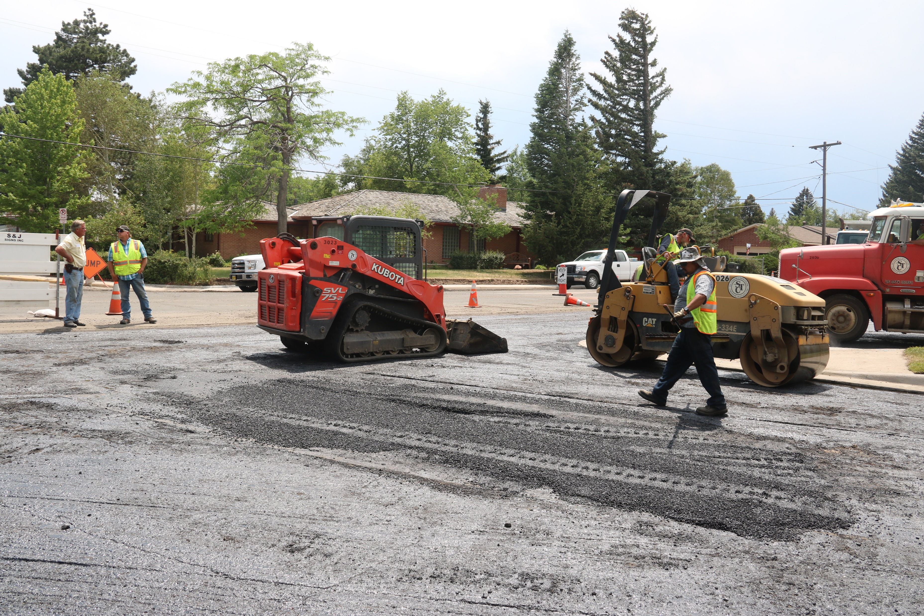
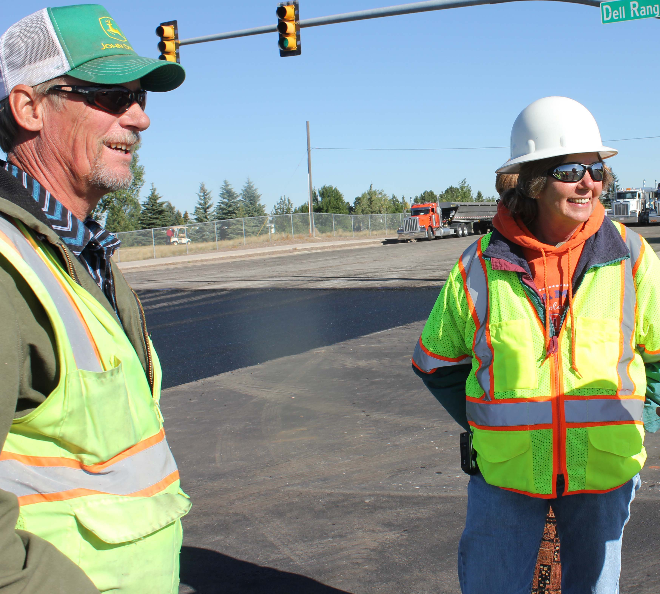
Street Related Work
  Administration of Construction Projects
    $3,000,000 ($750,000 yr)
    Funds Construction Management Personnel & Administrative Assistant in Addition to Vehicles, Equipment & Office Supplies

Slide 13
Major Street Projects $5 Million
  Priority 1: Reconstruct Converse Avenue
    Phase I: Greenway Pedestrian Bridge to Mason Way
    Phase II: Mason Way to East Carlson Street
  Priority 2: Realign Missile Drive at 19th Street
    Add New Bridge
    Improve Drainage & Safety
    Upgrade Pedestrian Corridor
  Priority 3: Storm Sewer Interceptor Duff & Bradley
    Improve Drainage
    Reduce Flooding

Slide 14
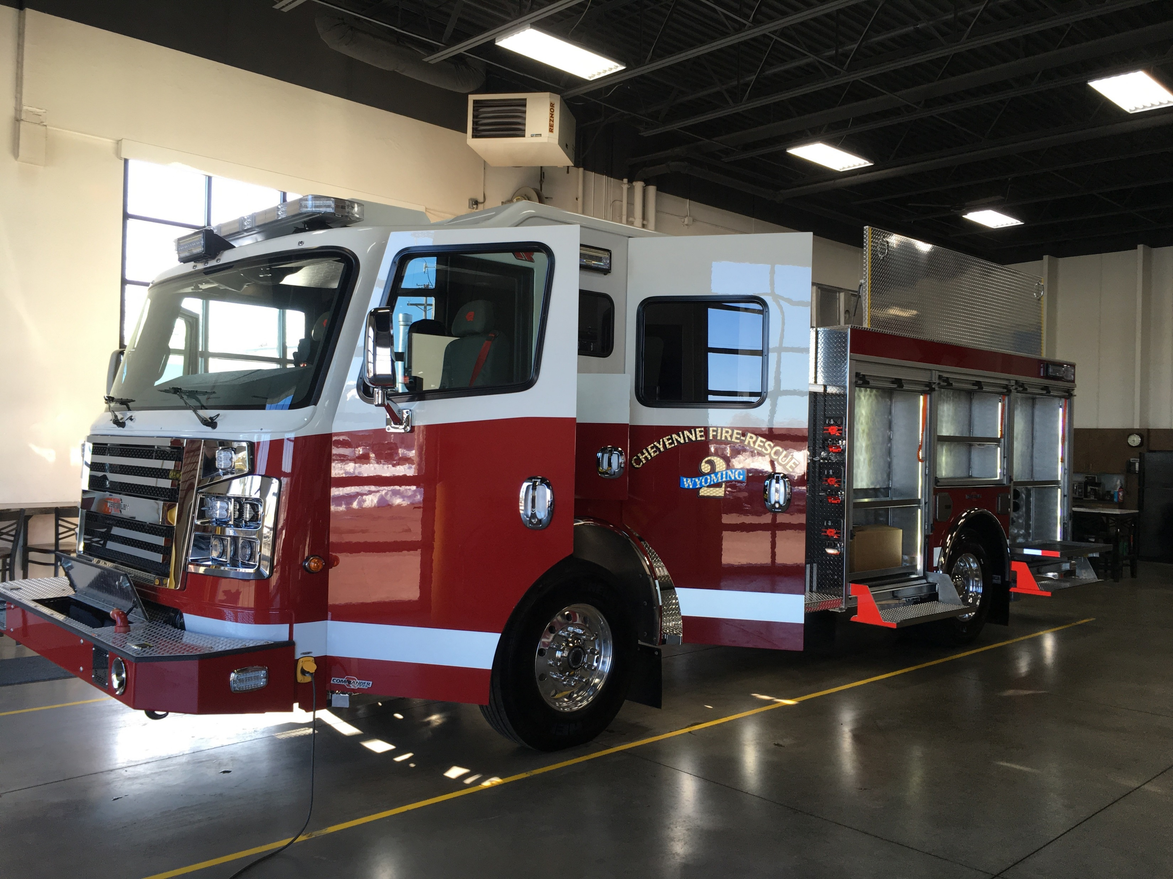
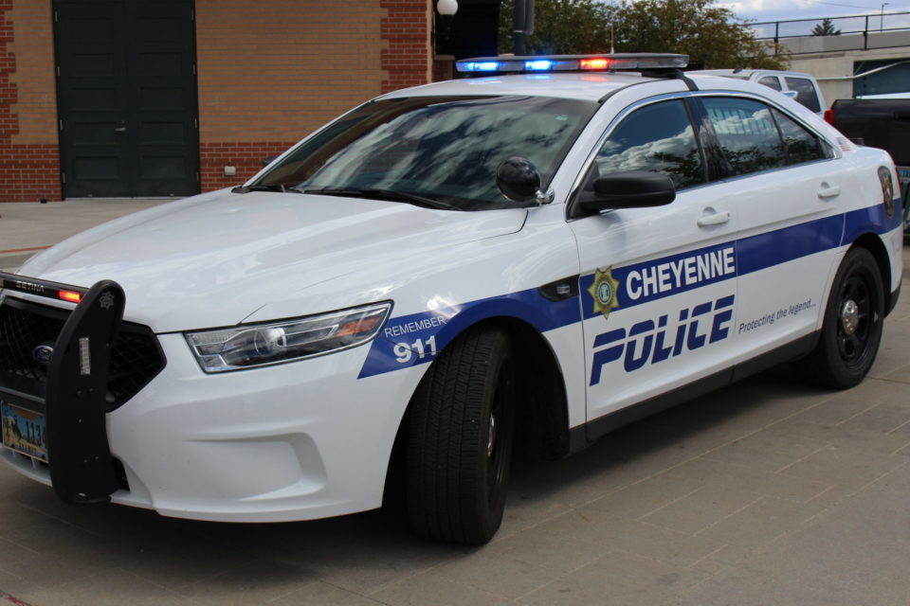
Other Agencies 20%
  Fire & Rescue – Facilities, Equipment, Training & Matching Funds $2,000,000 ($500,000 yr)
  Police – Vehicles, Communications Equipment, Training, Facilities $2,500,000 ($625,000 yr)

Slide 15
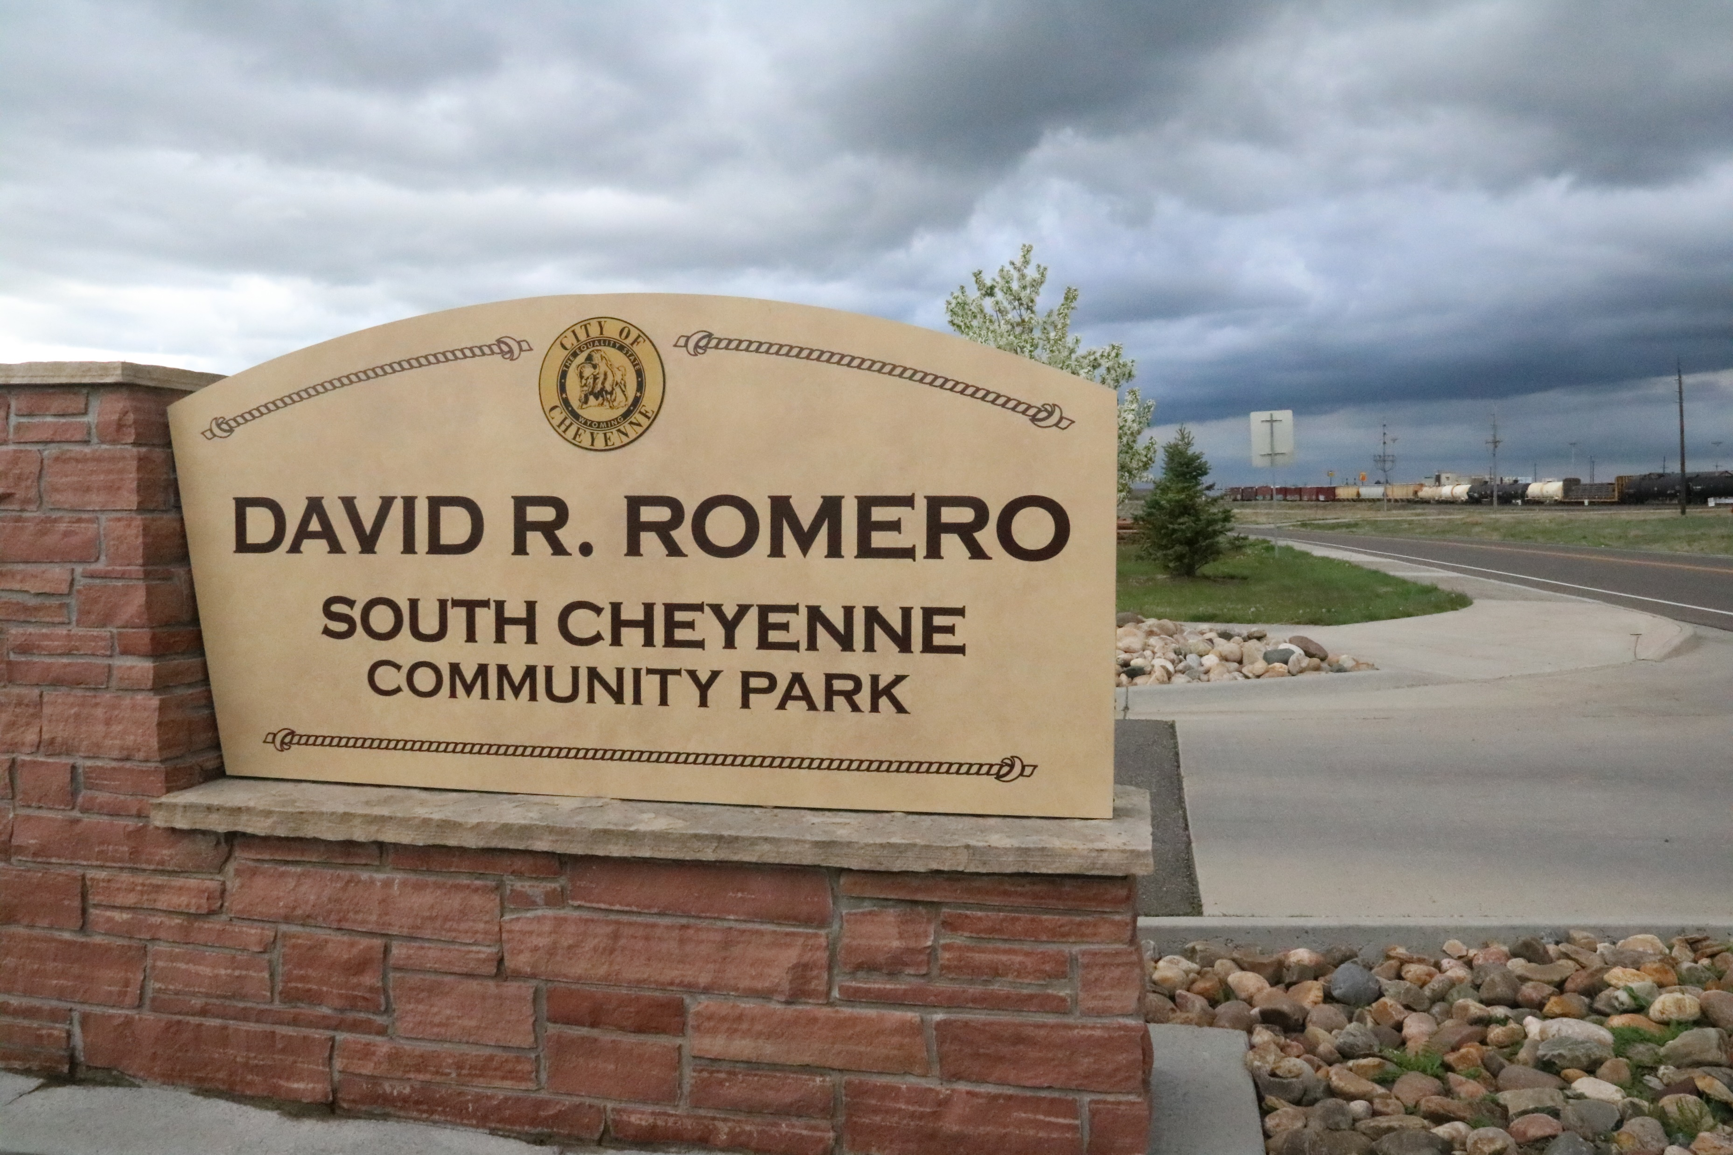
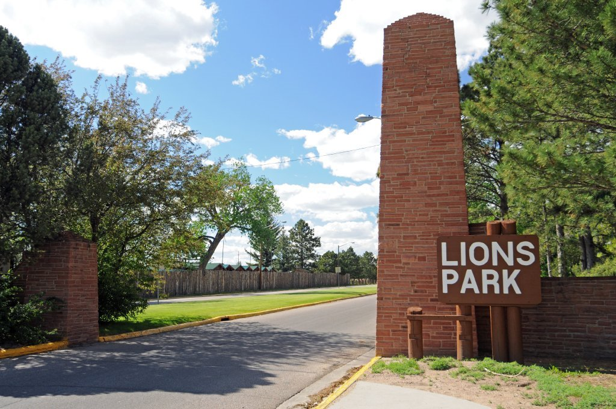
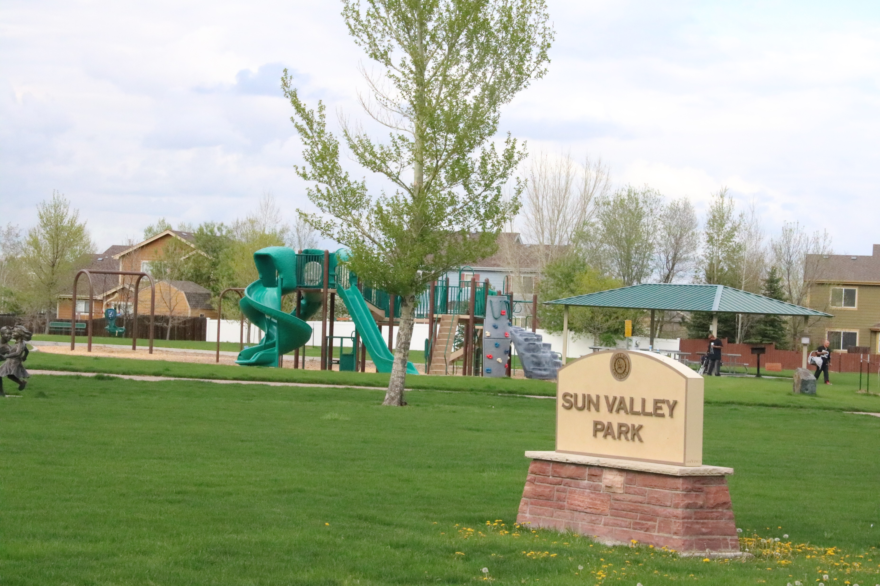
Other Agencies
  Community Recreation and Events
    $2,375,000 ($593,750 yr)
      Right-of-Way Maintenance
      Facilities, Equipment, Grounds and Programs
  Computers, Vehicles and Equipment
    $492,704 ($123,176 yr)

Slide 16
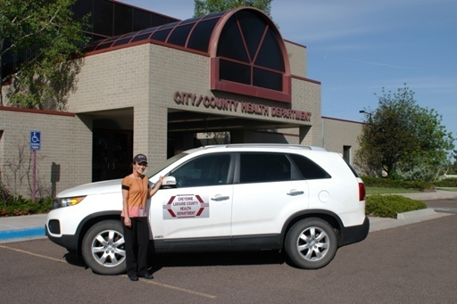
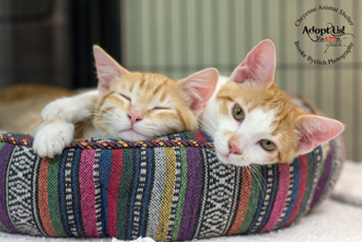
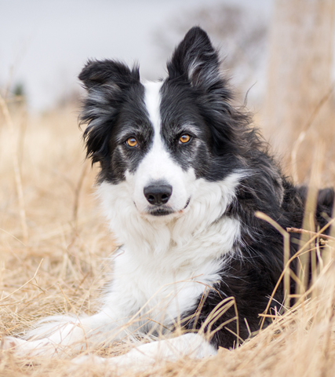
Other Agencies
  City/County Health
    $335,000 ($83,750 yr)
      Vehicles and Equipment
  Compliance for Animal Control
    $250,000 ($62,500 yr)
      Vehicles and Equipment
  Airport Board
    $247,296 ($60,000 then plus 2%)
      Annual Lease Agreements

Slide 17

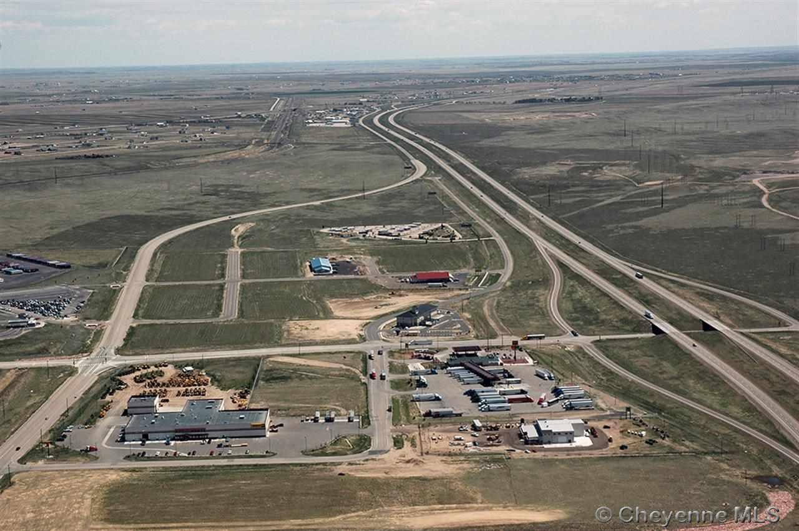

Other Agencies
  Human Services
    $1,000,000 ($250,000 yr)
      Financial Support to Local Agencies
  Economic Development
    $800,000 ($200,000 yr)
      Economic Development & Job Creation

Slide 18
Distribution

Slide 19
CONSTITUTIONAL AMENDMENT A
Wyoming Constitution Allows State to Invest in Equities
  State Treasurer’s Office Expert Investment Team
  Historically Higher Returns on Investments
Wyoming Constitution DOES NOT Allow Counties, Cities and Other Political Subdivisions to Invest in Equities
  Historically Lower Returns on Investments
Constitutional Amendment A
  Would Allow Counties, Cities and Other Political Subdivisions to Invest in Equities
  Share in Higher Returns
    Increased Revenue for City’s Day-to-Day Activities
Blank Counts as a NO VOTE!

Slide 20
QUESTIONS
DON’T FORGET TO VOTE!!!

